Slide 1
Python Async IO Intro
Focus on Gevent
殷理想
yinlixiang@aidigger.com

Slide 2
Contents
Background
Process, Thread, Coroutine
Sync&Async
Async Mechanism & Common Frameworks
Callback
Generator based coroutine
Greenlet
Gevent Implementation Analysis
Libev: Loop, watcher
Greenlet: hub, waiter

Slide 3
Background
Concurrence
Web Server:
Incoming Requests
Network functions:
web content
model result
result from other webservers
IO functions:
File R&W
DB CRUD
Data Reassemble & Calculation

Slide 4
Background
Solutions to Concurrence
Multi-Process
Multi-Thread
Coroutines
(async)

Slide 5
Background
Multi-Process
os.fork, multiprocessing
不共享任何状态
调度由操作系统完成
有独立的内存空间（上下文切换的时候需要保存栈、cpu寄存器、虚拟内存、以及打开的相关句柄等信息，开销大）
通讯主要通过信号传递的方式来实现（实现方式有多种，信号量、管道、事件等，通讯都需要过内核，效率低）

Slide 6
Background
Multi-Thread
Thread (GIL [1]), threading
共享变量（解决了通讯麻烦的问题，但是对于变量的访问需要加锁）
调度由操作系统完成（由于共享内存，上下文切换变得高效）
一个进程可以有多个线程，每个线程会共享父进程的资源（创建线程开销占用比进程小很多，可创建的数量也会很多）
通讯除了可使用进程间通讯的方式，还可以通过共享内存的方式进行通信（通过共享内存通信比通过内核要快很多）

Slide 7
Background
Coroutines
greenlet, stackless, gevent, eventlet…
调度完全由用户控制
一个线程（进程）可以有多个协程
每个线程（进程）循环按照指定的任务清单顺序完成不同的任务（当任务被堵塞时，执行下一个任务；当恢复时，再回来执行这个任务；任务间切换只需要保存任务的上下文，没有内核的开销，可以不加锁的访问全局变量）
协程需要保证是非堵塞的且没有相互依赖
协程基本上不能同步通讯，多采用异步的消息通讯，效率比较高

Slide 8
Background
How to decide?
CPU-Bound or IO-Bound?
Is IO really slow?
require doing things concurrently?
often spin up new, short lived, threads ?
…

Slide 9
Asynchronous I/O
Device support must not wait for slow I/O
Hardware read/write operations which take “a long time” to complete must use asynchronous record processing
TI/O ≥ 100 μs – definitely “a long time”
TI/O ≤ 10 μs – definitely “not a long time”
10 μs < TI/O < 100 μs – ???
If a device does not provide a completion interrupt, a “worker” thread can be created to perform the I/O
This technique is used for Ethernet-attached devices.
Notes:
This is where the actual control and data acquisition occurs.

Slide 10
Background
Concurrence
Web Server:
Incoming Requests
Network functions:
Fetch web content
Get model result
Wait response from other webservers
IO functions:
File R&W
DB CRUD
Data Reassemble & Calculation
Notes:
对于很多网络请求和需等待IO读写的服务可用协程异步的方式来提升性能

Slide 11
Async
Callback Style
Tornado
Twisted
Generator Style
Asyncio
Green Thread Style
Stackless (RIP)
Greenlet
Gevent

Slide 12
Async: Callback
import tornado.ioloop from tornado.httpclient import AsyncHTTPClient urls = ['http://www.google.com', 'http://www.yandex.ru', 'http://www.python.org'] def handle_response(response): if response.error: print("Error:", response.error) else: url = response.request.url data = response.body print('{}: {} bytes: {}'.format(url, len(data), data)) http_client = AsyncHTTPClient() for url in urls: http_client.fetch(url, handle_response) tornado.ioloop.IOLoop.instance().start()
Notes:
Test_callback.py

Slide 13
Async: Callback
Not like threaded programs at all
Threads/coroutines are invisible to the programmer
Callbacks swallow exceptions, violates PEP20
Errors should never pass silently.
Unless explicitly silenced.
Callbacks are not gather-able (hack around by global variables)
Callback after callback gets confusing and hard to debug
lose access to the stack and variables
Notes:
Saving results to some global state variables, in callback check if it’s the last result
long chain of callback after callback after callback
lose access to the stack and variables, you end up shoving large objects into all your callbacks
using 3rd party APIs, you can’t pass anything into the callback

Slide 14
Async: Callback
import tornado.ioloop from tornado.httpclient import AsyncHTTPClient urls = ['http://www.google.com', 'http://www.yandex.ru', 'http://www.python.org'] def handle_response(response): if response.error: print("Error:", response.error) else: url = response.request.url data = response.body print('{}: {} bytes: {}'.format(url, len(data), data)) http_client = AsyncHTTPClient() for url in urls: http_client.fetch(url, handle_response) tornado.ioloop.IOLoop.instance().start()
Notes:
对于某一个业务，我们更希望能在一块代码里完成，而不是分割成两部分，可读性变差。
一块代码运行到一半，遇到blocking，挂起等IO ready后再继续运行，可以联想到跟某个概念？？Generator yield

Slide 15
Generator
>>> from src.test_generator import countdown
>>> x = countdown(10)
>>> x
<generator object countdown at 0x00000175FE507A98>
>>> next(x)
Counting down from 10
10
>>> next(x)
9
…
>>> next(x)
1
>>> next(x)
Traceback (most recent call last):
File "<input>", line 1, in <module>
StopIteration
def countdown(n): print('Counting down from ', n) while n > 0: yield n n -= 1
Notes:
Test_generator

Slide 16
Generator
def grep(pattern, lines): for line in lines: if pattern in line: yield line if __name__ == '__main__': text = ['python rocks', 'pth rck', 'python3.5', 'pp test'] pattern = 'python' for line in grep(pattern, text): print(line)
(venv) src> python test_generator.py
python rocks
python3.5

Slide 17
Async: Generator Based Coroutine
>>> from src.test_coroutine import grep_first
>>> g = grep_first('python')
>>> g
<generator object grep_first at 0x00000175FE667620>
>>> next(g)
Looking for python
>>> g.send('test')
>>> g.send('python rocks!')
python rocks!
>>> g.close()
>>> g.send('test')
Traceback (most recent call last):
File "<input>", line 1, in <module>
StopIteration
>>> from src.test_coroutine import grep_first
>>> g = grep_first('python')
>>> g
<generator object grep_first at 0x00000175FE507AF0>
>>> g.send('python go!')
Traceback (most recent call last):
File "<input>", line 1, in <module>
TypeError: can't send non-None value to a just-started generator
def grep_first(pattern): print('Looking for {}'.format(pattern)) while True: line = (yield) if pattern in line: print(line)
Notes:
See test_Coroutine.py for more usages
Coroutine wrapper
Exception

Slide 18
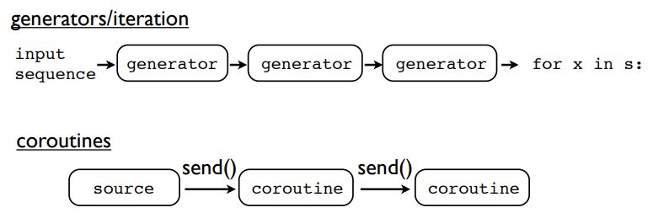
Async: Generator Based Coroutine
Generators produce data for iteration
Coroutines are consumers of data
Notes:
Key difference:
Generators pull data through the pipe with iteration.
Coroutines push data into the pipeline with send().

Slide 19
Coroutines as tasks
Tasks have a few essential features
Independent control flow
Internal state
Can be scheduled (suspended/resumed)
Can communicate with other tasks
Task Switching & Scheduling
Hint: OS
Interrupts & Traps
Notes:
You can package coroutines inside threads or subprocesses by adding extra layers
You send data to coroutines
You send data to threads (via queues)
You send data to processes (via messages)
Coroutines naturally tie into problems involving threads and distributed systems.
Coroutines as tasks
定义的函数本身就是一串指令或控制流
函数内有局部变量，只要协程未结束或被关闭，局部变量会一直存在
yield suspends execution
send() resumes execution
close() terminates execution
协程间通过send(data)进行通信
OS: gain control by
Interrupts: Some kind of hardware related signal (data received, timer, keypress, etc.)
Traps: A software generated signal

Slide 20
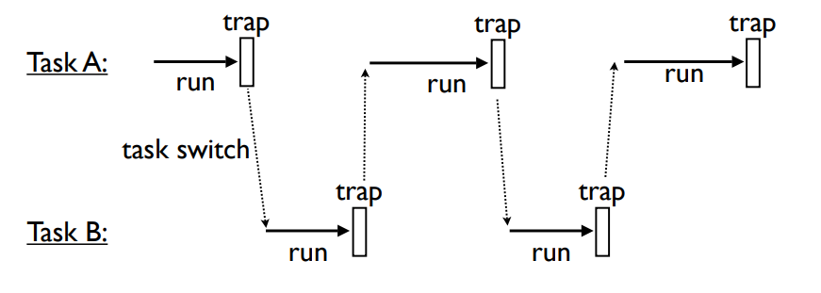
OS: Task Switching

Slide 21
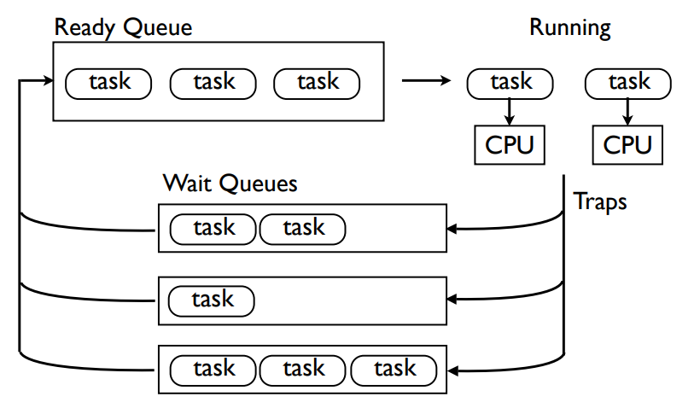
OS: Task Scheduling

Slide 22
Demo: Task Scheduler
More:
Protection
Tasks do not see the scheduler
Tasks do not see other tasks
Yield is the only external interface
Task Management functions
Create a new task
Kill an existing task
Wait for a task to exit
Coroutine Trampolining
Inter-task Communication
Handling of blocking operations
Error Handling
…
Notes:
The task that waits has to remove itself from the run queue.
更多的可参考More

Slide 23
Yield VS Yield from
# Implementation in pre-3.3 Python def chain(*generators): for generator in generators: for item in generator: yield item # Implementation in post-3.3 Python def chain(*generators): for generator in generators: yield from generator
A generator can only yield to its immediate caller
Sub-generators: code reuse and modularity
Manually iterate and re-yield all the results
Tedious and inefficient
a yield from statement to delegate control entirely to another generator
In the case of coroutines, sent values and thrown exceptions are also propagated directly to the currently executing sub-generator.
Notes:
A generator can only yield to its immediate caller
if you want to split generators up for reasons of code reuse and modularity, the calling generator would have to manually iterate the sub-generator and re-yield all the results
This is tedious and inefficient.
a yield from statement to delegate control entirely to another generator
The subgenerator is run to completion, with results being passed directly to the original caller without involvement from the calling generator. In the case of coroutines, sent values and thrown exceptions are also propogated directly to the currently executing subgenerator.

Slide 24
Yield VS Yield from
_i = iter(EXPR) try: _y = next(_i) except StopIteration as _e: _r = _e.value else: while 1: try: _s = yield _y except GeneratorExit as _e: try: _m = _i.close except AttributeError: pass else: _m() raise _e except BaseException as _e: _x = sys.exc_info() try: _m = _i.throw except AttributeError: raise _e else: try: _y = _m(*_x) except StopIteration as _e: _r = _e.value break else: try: if _s is None: _y = next(_i) else: _y = _i.send(_s) except StopIteration as _e: _r = _e.value break RESULT = _r
RESULT = yield from EXPR

Slide 25
Async: Coroutines with yield from
import asyncio import aiohttp urls = ['http://www.google.com', 'http://www.yandex.ru', 'http://www.python.org'] @asyncio.coroutine def call_url(url): print('Starting {}'.format(url)) with aiohttp.ClientSession() as session: response = yield from session.get(url) data = yield from response.text() print('{}: {} bytes: {}'.format(url, len(data), data)) return data futures = [call_url(url) for url in urls] loop = asyncio.get_event_loop() loop.run_until_complete(asyncio.wait(futures))
Notes:
@asyncio.coroutine => futures == task
Loop == scheduler

Slide 26
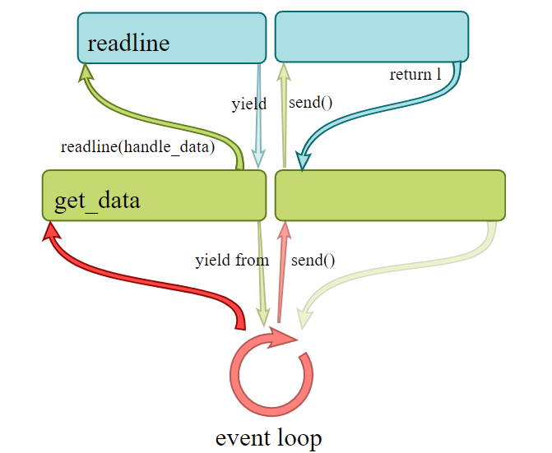
Async: Coroutines with yield from

Slide 27
Async: asyncio
import asyncio import aiohttp urls = ['http://www.google.com', 'http://www.yandex.ru', 'http://www.python.org'] async def call_url(url): print('Starting {}'.format(url)) async with aiohttp.ClientSession() as session: response = await session.get(url) data = await response.text() print('{}: {} bytes: {}'.format(url, len(data), data)) return data futures = [call_url(url) for url in urls] loop = asyncio.get_event_loop() loop.run_until_complete(asyncio.wait(futures))
Notes:
With the introduction of the core library, they also added the keywords async and await in Python 3.5.
把@asyncio.coroutine替换为async；
把yield from替换为await。

Slide 28
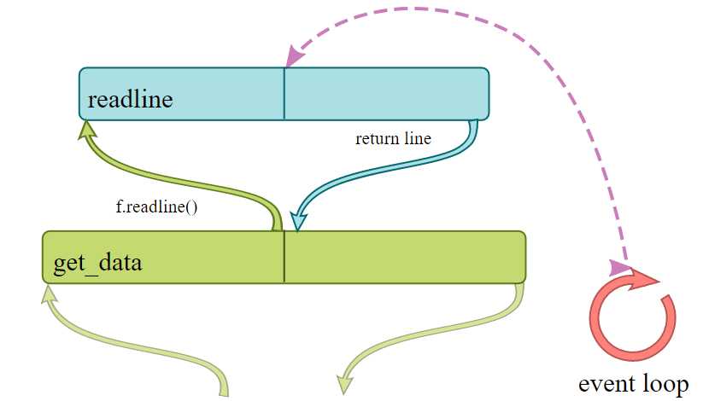
Async: green thread style(gevent)
import gevent def foo(): while True: print('foo is running') gevent.sleep(0.5) def bar(): while True: print('bar is running') gevent.sleep(0.5) tasks = [gevent.spawn(foo), gevent.spawn(bar)] gevent.joinall(tasks)
Notes:
test_gevent_intro.py
Event loop被隐藏

Slide 29
Async: green thread style(gevent)
Gevent Componets:
Task: Greenlet
waiter
Scheduler: Hub
loop: libev
watcher
Monkey Patch
Patch_time()
Gevent.sleep() vs time.sleep()

Slide 30
Greenlet
from greenlet import greenlet def test1(x, y): z = gr2.switch(x+y) print(z) def test2(u): print(u) gr1.switch(42) gr1 = greenlet(test1) gr2 = greenlet(test2) gr1.switch("hello", " world")
greenlet只提供协程本身,要在协程间切换调度必须你在程序中手动来进行 API: greenlet(run=None, parent=None): create a greenlet instance greenlet.getcurrent Attributes and methods: gr.parent: 每一个协程都有一个父协程,当前协程结束后会回到父协程中执行,该属性默认是创建该协程的协程 gr.run: 该属性是协程实际运行的代码. run方法结束了,那么该协程也就结束了. gr.switch(*args, **kwargs): 切换到gr协程. gr.throw(): 切换到gr协程,接着抛出一个异常.
Notes:
Generator based coroutine通过yield归还控制权到主调用者，无法互相传值，只能通过主调用者传递
greenlet通过switch在greelet间自由切换并传值

Slide 31
Demo: start from gevent.spawn
Notes:
Test_tracing.py

Slide 32
Hub: A greenlet that runs the event loop
loop

Slide 33
libev loop
watcher
callback
c_watcher
gevent_callback
epoll
…

Slide 34
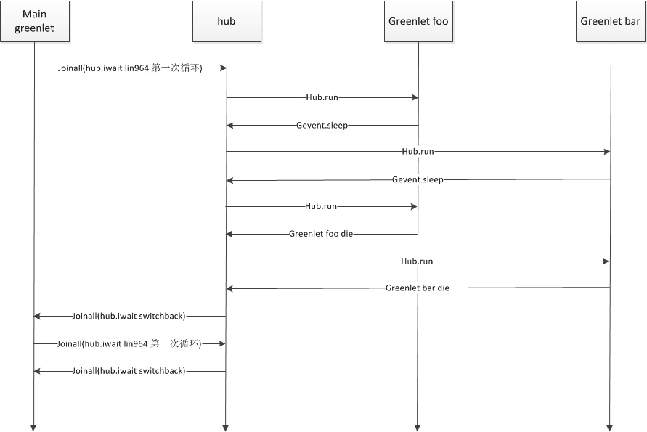
tracing
Notes:
Test_tracing.py

Slide 35
References
GIL
http://www.dabeaz.com/GIL/
asyncio:
https://hackernoon.com/asynchronous-python-45df84b82434
https://hackernoon.com/async-through-the-looking-glass-d69a0a88b661
PEP 380: Syntax for Delegating to a Subgenerator
https://docs.python.org/3/whatsnew/3.3.html#pep-380
generator:
https://hackernoon.com/the-magic-behind-python-generator-functions-bc8eeea54220
http://www.dabeaz.com/coroutines/Coroutines.pdf
gevent:
http://mauveweb.co.uk/posts/2014/07/gevent-asynchronous-io-made-easy.html
https://zaiste.net/async_python_gevent_introduction/
https://yuyang0.github.io/articles/gevent.html
http://hhkbp2.github.io/gevent-tutorial/
http://blog.csdn.net/yueguanghaidao/article/details/39122867
https://softlns.github.io/2015/11/28/python-gevent/
http://python.jobbole.com/88149/
greenlet:
http://www.bkjia.com/Pythonjc/883698.html
https://greenlet.readthedocs.io/en/latest/
https://github.com/python-greenlet/greenlet
libev
http://pod.tst.eu/http://cvs.schmorp.de/libev/ev.pod
http://blog.csdn.net/fjslovejhl/article/details/39153861

